Slide 1
Streamroot test
Test Product Manager Dashboard & API
Problem A : Monitoring of Streamroot Client Release

Slide 2
Problem A

Slide 3
SR cli release monitoring | key features
Show viewers cli versions (only visible for connected clients)
Aggregate metrics (release versions) sent by each clients
Give means for comparision between release version
Provide metrics to measure quality of release (the metric should be discussed with each customer) and its effect on Streamroot Product
Provide metrics on client upgrades

Slide 4
Feature requirements (feasability/complexity/cost should be discussed with engineering team)
Req description | Priority | Feasability | Complexity | Cost
Connected client number | Must have | high | low | low (already done in different dashboard)
Connected client with latest release number and ratio with total | Must have | medium (data aggragation) | medium (data aggragation) | medium (data aggregation is possible for
Pourcentages of users using specific release | Should have | medium | medium | medium
Filter per customer | Must have | High | High
For customer only : No access to other customer data | Must have | High | High | medium
Filter per platform | Nice to have | High | Low (already possible) | Low

Slide 5
Feature req
Req description | Priority | Feasability | Complexity | Cost
Release deployment growth | Nice to have | High | medium | medium
Global efficiency (or any measure of DNA global quality) | Nice to have | High | Low | Low (already done)
Global efficiency growth | Nice to have | High | medium | medium
Filter : Refresh time for KPI growth calculation | Nice to have | High | medium | medium
Client number per release | Should have | Medium | Medium | Medium
Latest release date | Must have | Medium | Medium | Medium
Latest release information (name/version) | Must have | Medium | Medium | Medium
Release description | Nice to have | Medium | Medium | Medium

Slide 6
SR cli release monitoring | target users
Customers
Support team
>> Both can only consult dashboard app, with their own context

Slide 7
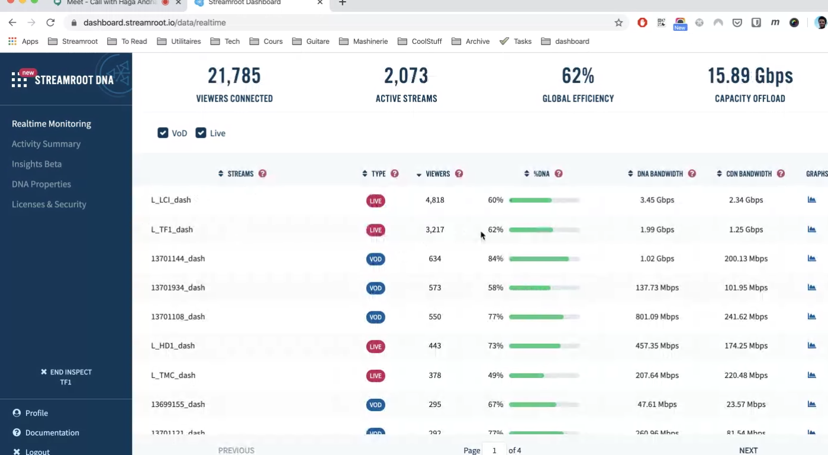

Slide 8
21000 | 7000 (33%) | 1.3.0 | 04-07-2020 12:00pm | 60 %
# connected viewer clients | # connected clients with latest release | Latest Client Release version | Latest release date | Global Efficiency
+30% in the last day
+7% in the last day
Realtime Monitoring
Filter section
Refresh delay : 1 day (parametrable dropdown)
Platform: all
(parametrable dropdown)
Customer: all
(not parametrable for customers)
33%
33%
33%
Release 1.2.1
Release 1.2.2
Release 1.3.0
Release Monitoring
(on hover, not mandatory)
Release description:
-name
-short description
-target platform(s)

Slide 9
SR cli release monitoring | HL architecture
Data aggregation
Dashboard app | Release Monitoring
Aggregated data
SR server(s)
SR client
SR client
SR client
Connected SR client(s)
Latest
Release information
Release system

Slide 10
Potential Moitoring API
Endpoints :
GET https://apiv2.streamroot.io/data/releaseversions
Response with total of connected clients + their versions
CICDpipeline API to fetch last release version

Slide 11
Exercice 2: Basic Streamroot hacking

Slide 12
NodeJS server with 3 pages
/demo : for testing video.js player and graph lib
/demol3 : with video with Level3 HLS stream source, with p2p upload enablement button
/democf : with video with Cloudfront HLS stream source

